Slide 1


Forecasting at scale
Introduction
SoyGema

Slide 2

WHY ?
Notes:
Forecasting is a data science task that is central to many activities within an organization.
Helps to take decisitions, identify different trends

Slide 3

WHY ?
1
Notes:
Completely automatic forecasting techniques can be brittle and they are often
too inflexible to incorporate useful assumptions or heuristics
FRAGILES e INFLEXIBLES

Slide 4

WHY ?
1
Notes:
Analysts who can produce high quality forecasts are quite rare because forecasting is a specialized data science skill requiring substantial experience

Slide 5
WHAT ?
Notes:
So Prophet is born to bring this tools to non-forecasting design experts
And made this tool for junior data scientists and data analysts
to make high quality forecasts that keep up with demand.

Slide 6
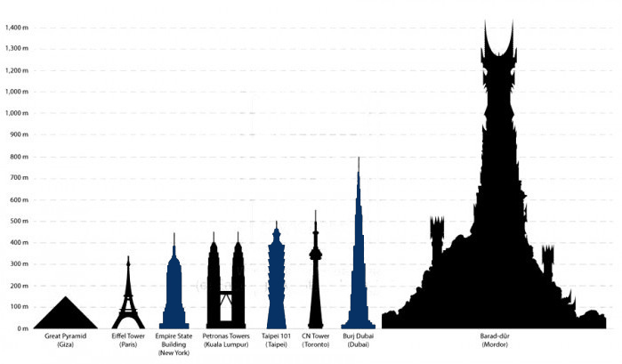
WHAT ?
2
Notes:
The problems of scale we have observed in practice involve
the complexity introduced by the variety of forecasting problems
and building trust in a large number of forecasts once they have been produced.
Los problemas de escala no vienen tanto de escalar infraestructura como de
La variedad de problemas de forecasting y de construir confiabilidad o fiabilidad en un gran numero de resultados

Slide 7
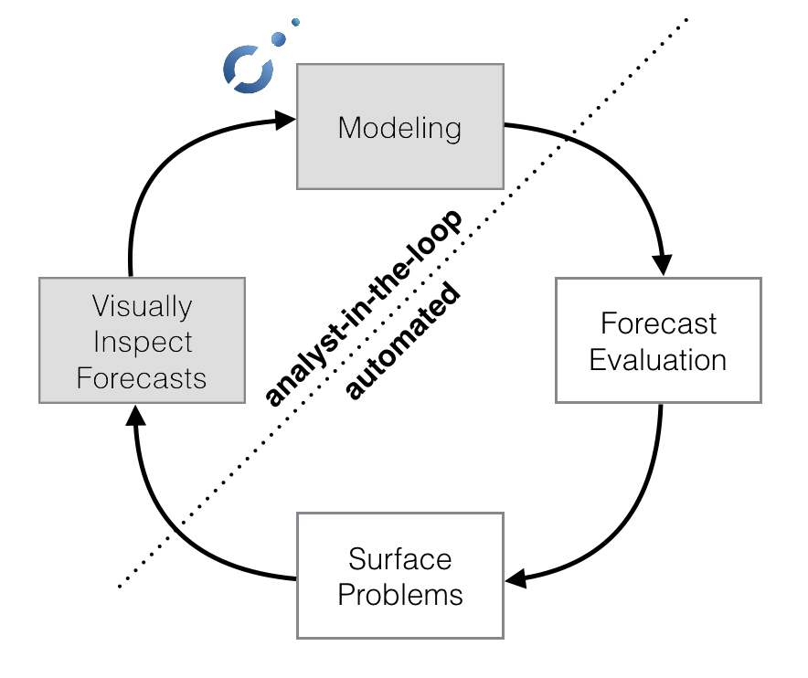

WHAT ?
2
Notes:
The following diagram illustrates the forecasting process we have found to work at scale

Slide 8
WHERE ?
Notes:
Where prophet shines

Slide 9

WHERE ?
3
Hourly, daily, or weekly observations with at least a few months (preferably a year) of history
Notes:
Not all forecasting problems can be solved by the same procedure.

Slide 10
WHERE ?
3
8760
Hours Data-input
365
Day Data-input
52
Week Data-input
Notes:
Not all forecasting problems can be solved by the same procedure.

Slide 11
WHERE ?
3
strong multiple “human-scale” seasonalities: day of week and time of year
Notes:
Not all forecasting problems can be solved by the same procedure.

Slide 12
WHERE ?
3
historical trend changes, for instance due to product launches or logging changes
Notes:
Not all forecasting problems can be solved by the same procedure.

Slide 13
WHERE ?
3
Trends that are non-linear growth curves, where a trend hits a natural limit or saturates
Notes:
Not all forecasting problems can be solved by the same procedure.

Slide 14
HOW ?
Notes:
Nonparametric regression is a category of regression analysis
in which the predictor does not take a predetermined form
but is constructed according to information derived from the data

Slide 15
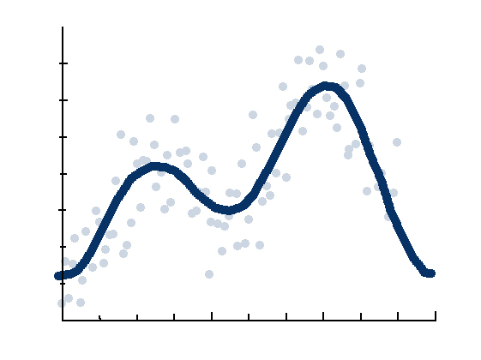
HOW ?
Notes:
Not all forecasting problems can be solved by the same procedure.

Slide 16
HOW ?
3
A piecewise linear or logistic growth curve trend. Prophet automatically detects changes in trends by selecting changepoints from the data.
A yearly seasonal component modeled using Fourier series.
A weekly seasonal component using dummy variables.
A user-provided list of important holidays.
Notes:
Not all forecasting problems can be solved by the same procedure.

Slide 17
DEMO

Slide 18

Asteroid detection
3
Notes:
Data from 1937 to 2017

Slide 19
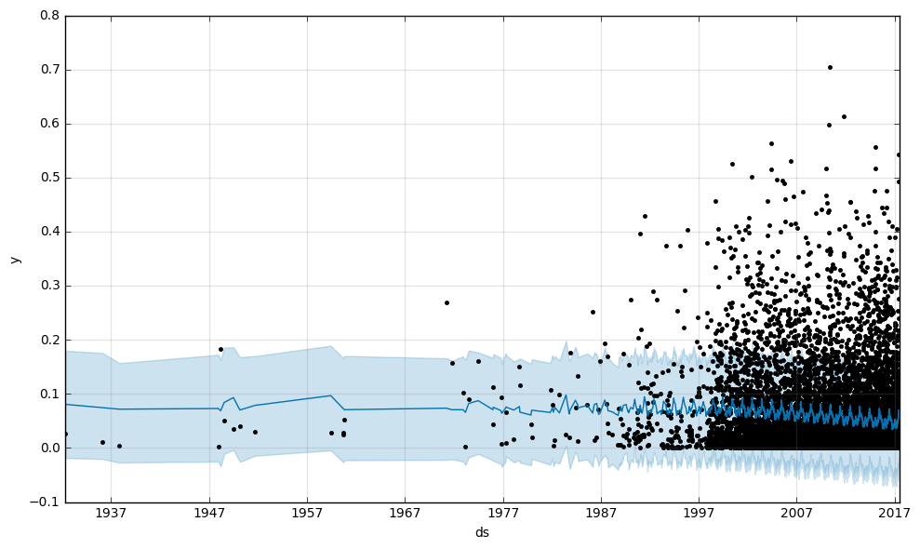
V2
3
Notes:
Data from 1937 to 2017

Slide 20
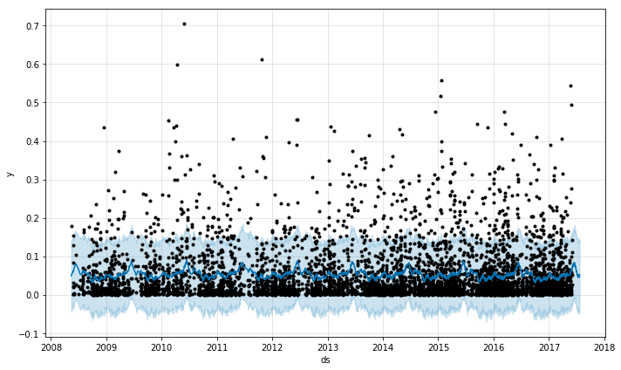
V3
3
Notes:
Data from 10 years

Slide 21
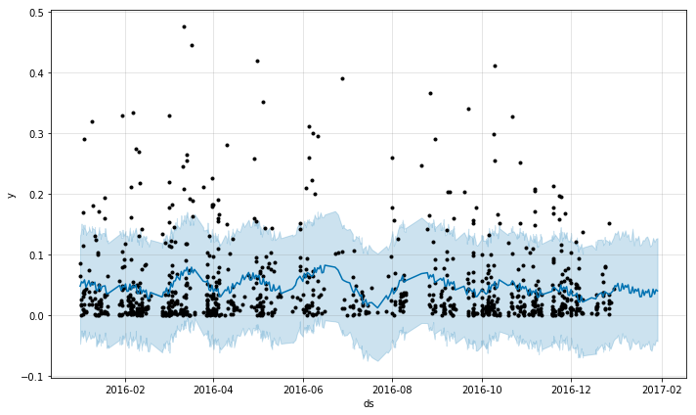
V3
3
Notes:
Data from 1 years

Slide 22
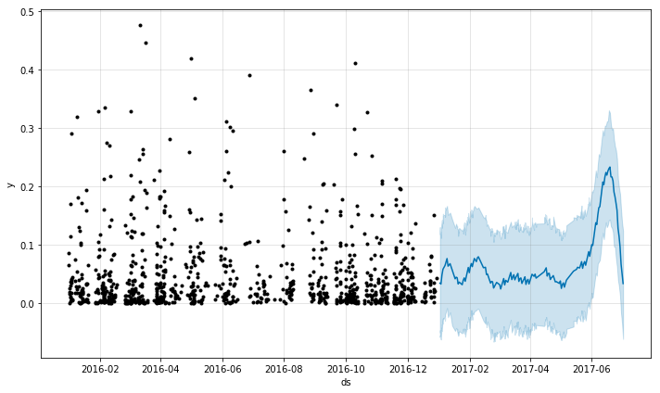
V3
3
Notes:
Data from 6 months

Slide 23
Thanks!
Github.com/SoyGema/Prophet_forecasting

